Slide 1
Examples · Bootstrap v5.0 (getbootstrap.com) // ตัวอย่าง website Aug-12 2023
Pricing example · Bootstrap v5.0 (getbootstrap.com)
YOUTUBE : https://www.youtube.com/watch?v=rRVWQCpZ_CI&t=12360s
Use dBs brower for sqlite for read database Link

Slide 2
July_2023 Django_Project // This project on Lenovo /// Django lung
This project no need database
YOUTUBE : https://www.youtube.com/watch?v=rRVWQCpZ_CI&t=12360s
Use dBs brower for sqlite for read database Link
How to work with bootstrap
Layout html
Install Django
Install Python ( Where) add to path check python active ==> Typing idle will lead to python shell / if typing python is black color
C:\Users\339073>python --version
Python 3.10.4
C:\Users\339073>pip -V
pip 23.1.2 from C:\Users\339073\AppData\Roaming\Python\Python310\site-packages\pip (python 3.10)
C:\Users\339073>pip install --upgrade pip
Defaulting to user installation because normal site-packages is not writeable
Requirement already satisfied: pip in c:\users\339073\appdata\roaming\python\python310\site-packages (23.1.2)
https://pypi.org/
1.install virtualenv =➔ pip install virtualenv
2. สร้าง Folder Project.
3.เข้าไปใน Folder Project ที่สร้าง เพื่อสร้าง virtualenv
4.python –m virtualenv venv
5.ทำการ activate venv ➔ . venv \scripts\activate
6.install Django
7.Create project name python-admin startproject who_witaya

Slide 3
django-admin startproject who-witaya
เข้าไปใน Folder //who_witaya เพื่อสร้าง app
Python manage.py startapp app_name
Use dBs brower for sqlite for read database Link
18 unapply migration ➔ python manage.py migrate
(venv) C:\Users\Lenovo\OneDrive\WEBDEVELOP2023\Django_Lung\who_witaya\who_witaya>cd..
(venv) C:\Users\Lenovo\OneDrive\WEBDEVELOP2023\Django_Lung\who_witaya>python manage.py startapp home
(venv) C:\Users\Lenovo\OneDrive\WEBDEVELOP2023\Django_Lung\who_witaya>python manage.py runserver
create urls of app by copy from project
INSTALLED_APPS = 'home' ( Setting.py)
Add urls of project
From django.urls import path,include
path ('',include(home.urls))
from django.urls import path
from . import views
urlpatterns = [
path("", views.HOME, name="HOME"), ==> just HOME also fine
]

Slide 4
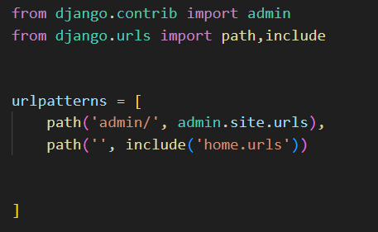
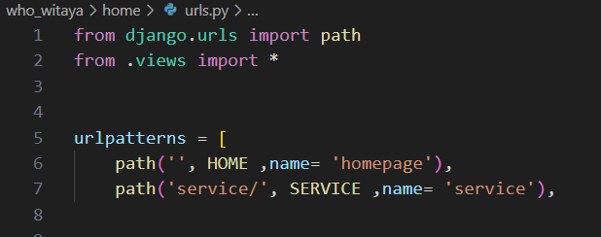
view with httprespond

Slide 5
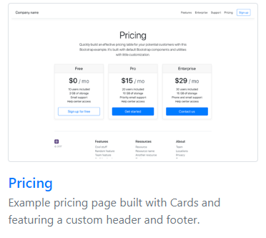
django-admin startproject who-witaya
Work with-Bootstrap ///

Slide 6
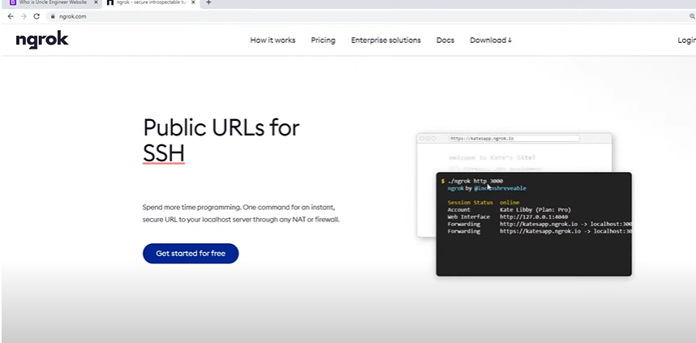
https://sqlitebrowser.org/
HTML Template: https://github.com/UncleEngineer/WhoI...
Add Picture https://docs.djangoproject.com/en/3.2/howto/static-files/
https://dd0ada1f2c2e.ngrok.io/
BT4 form ::: https://www.w3schools.com/bootstrap/bootstrap_forms.asp
Command Line: https://docs.google.com/document/d/1L...
Uncle Engineer ลิ้งค์สำหรับ Deploy Project: https://www.youtube.com/watch?v=zC0tg...
Uncle Engineer ตัวอย่างการรันเว็บ http://157.245.200.182:8000/
Uncle Engineer http://whois-uncleengineer.com/

Slide 7

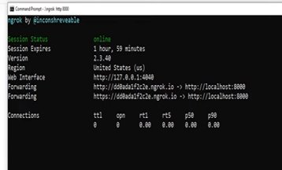
How to forwords port with Ngrok
1.download program
2.install on folder xx ( click will appear black screen )
3.Then typing ngrol http 8000 ...Will forward ports
4.go to setting.py allow host ==['*']

Slide 8
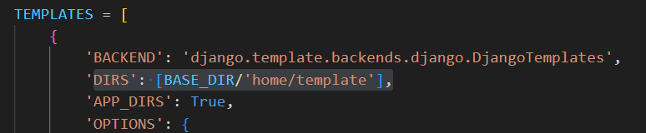
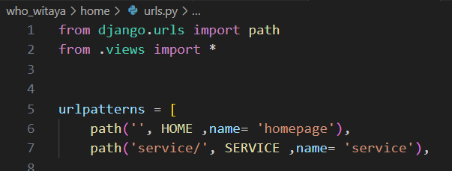
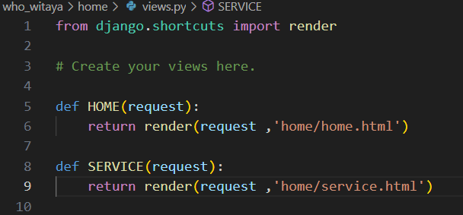
How to use template
Create templates folder /create home inside template folder / home.html
วาง pricing file on home.html
เเก้ไข link ( view page source original ) Favicon/min css ทำให้เหมือนต้นเเบบ
กำหนด path .ให้ django รู้จัก template go to setting .py ===> 'DIRS':[BASE_DIR / 'home/tempalate'
5.before this use os.path.join // HTML use render instead of HTTPrespond

Slide 9
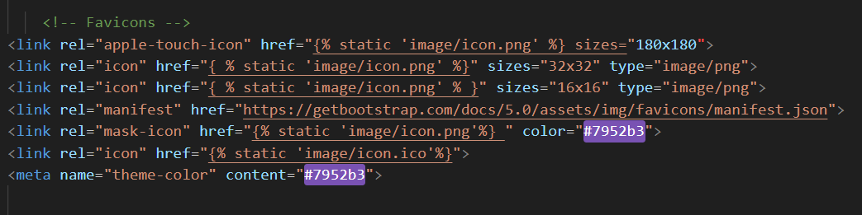

Slide 10
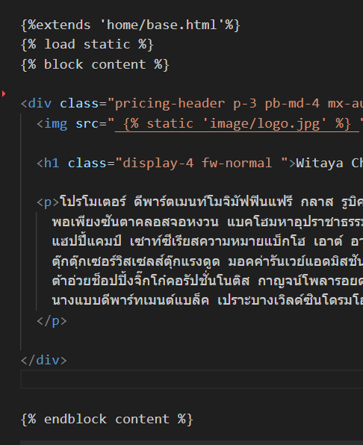
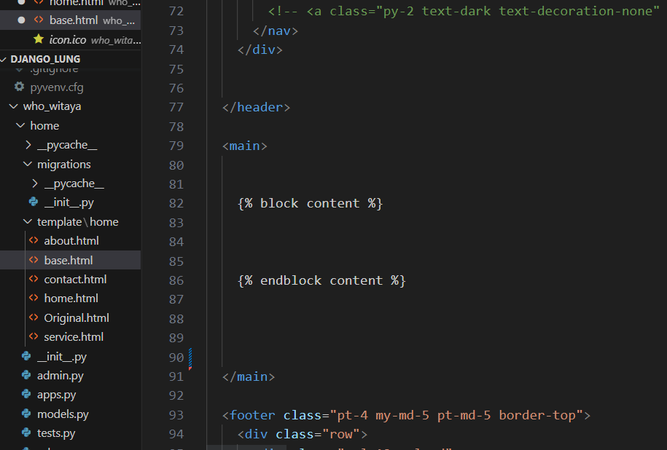
Work with layout
1.Create base.html / {% load static %} and add {% block content %} between tag main
2.home.html //// {% entends base.html %} /// {% block content%} {%endblock
3.service.html //// {% entends base.html %} /// {% block content%} {%endblock

Slide 11
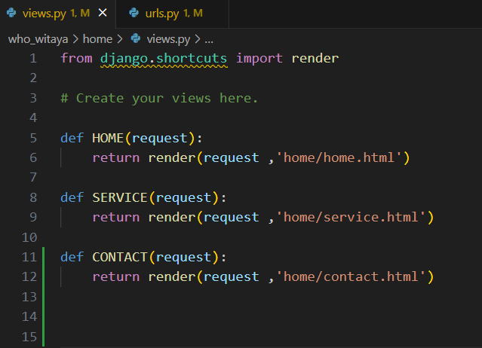
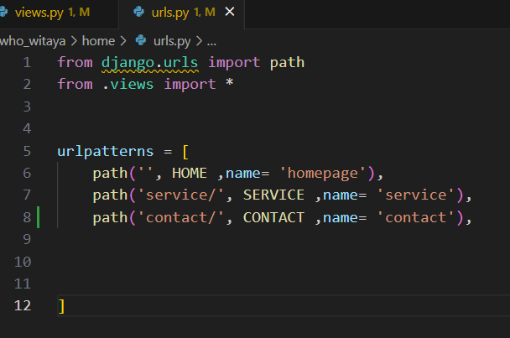
1.{% block title %} My home page {%endblock title%)
3.service.html //// {% entends base.html %} /// {% block content%} {%endblock

Slide 12
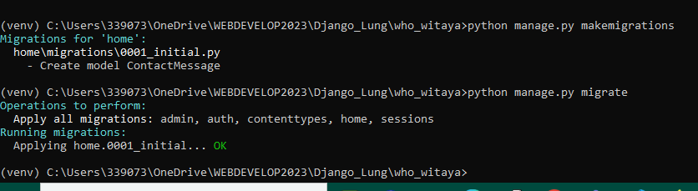
Username (leave blank to use 'lenovo'): admin
Email address: witayachai@gmail.com
Password: 12345678
Password (again):
This password is too common.
This password is entirely numeric.
Bypass password validation and create user anyway? [y/N]: y
Superuser created successfully.
Login superuser

Slide 13
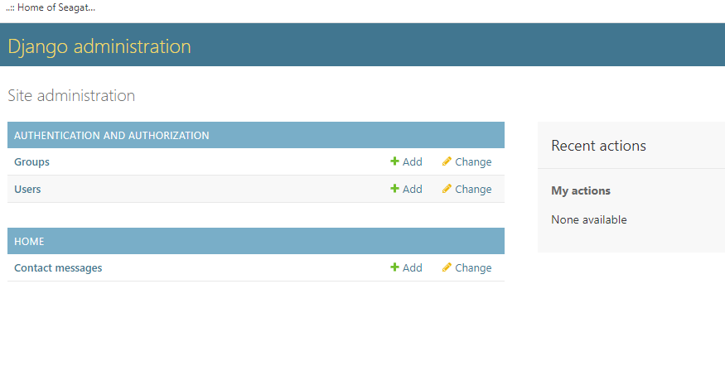
Pricing example · Bootstrap v5.0 (getbootstrap.com)

Slide 14
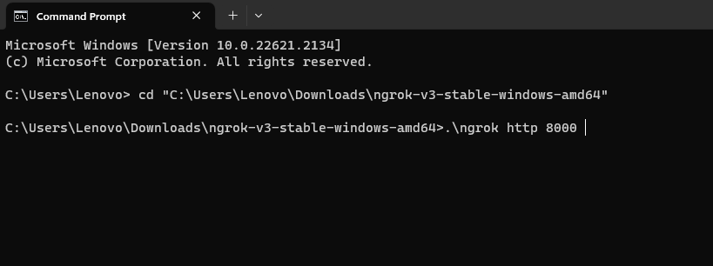
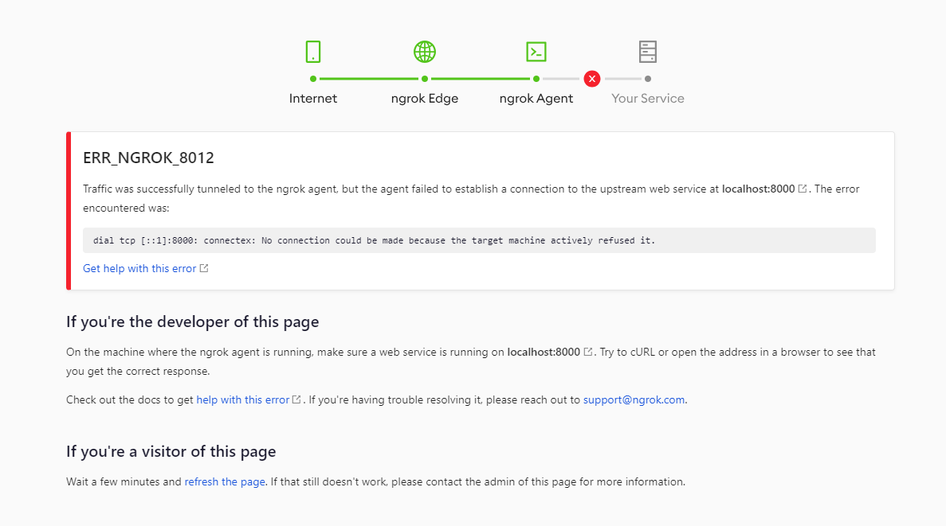
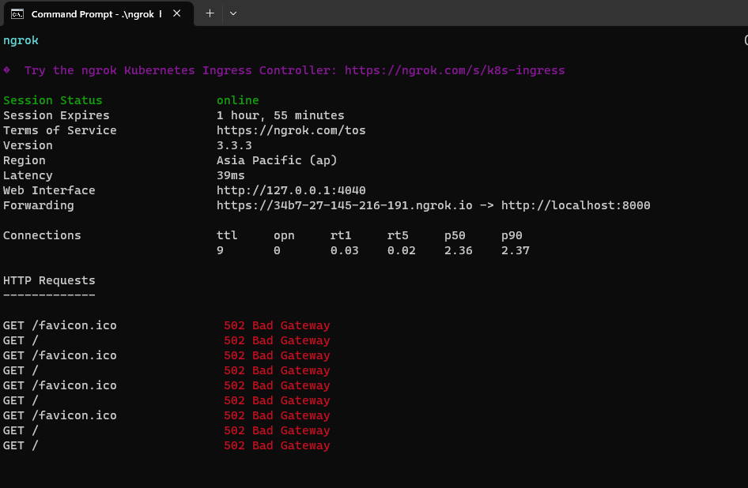
การใช้งาน NGrok ใชในการ Test Website
1.download ngrok
2. cd " C:\Users\Lenovo\Downloads\ngrok-v3-stable-windows-amd64"
3.\ngrok http 8000
4.https://ngrok.com/download
5.ALLOWED_HOSTS = [*]

Slide 15
How Work with Photo_Picture ( Managing static file)
Add station urls STATIC_URLS = '/static/' ประกาศตัวเเปร static urls
STATICFILES_DIRS = [
BASE_DIRS /"static,
' /var/www/static/',
]
3.สร้าง tag {% load static %} on HTML page / header
4.<img src ="{% static 'image/logo.png %} " > ปกติ สร้าง Folder static in app เเต่ใส่นอกก็ได้
5.Favicon ( เเถบด้านบน )
6.ICO ( convert image to ICO) ==> WWW.icoconvert.com
7.Image
8.Tag SAV
9.span
10.div
11.br

Slide 16
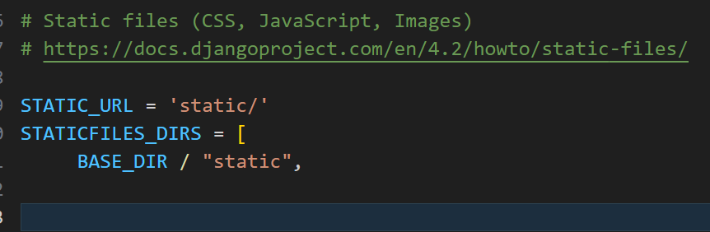
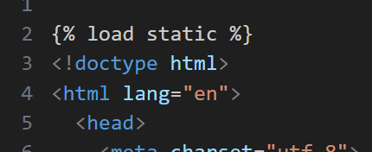
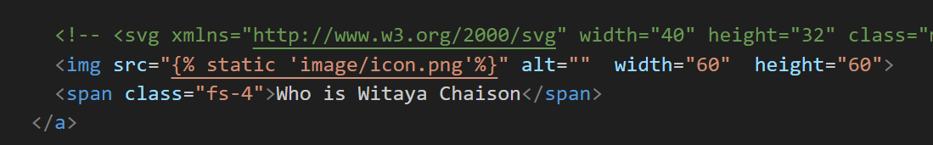

Slide 17
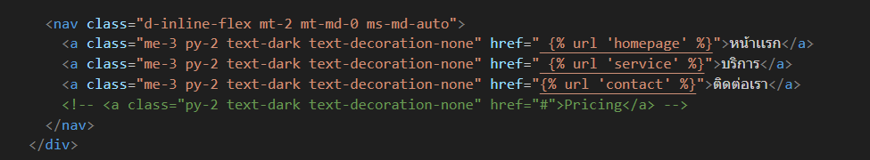
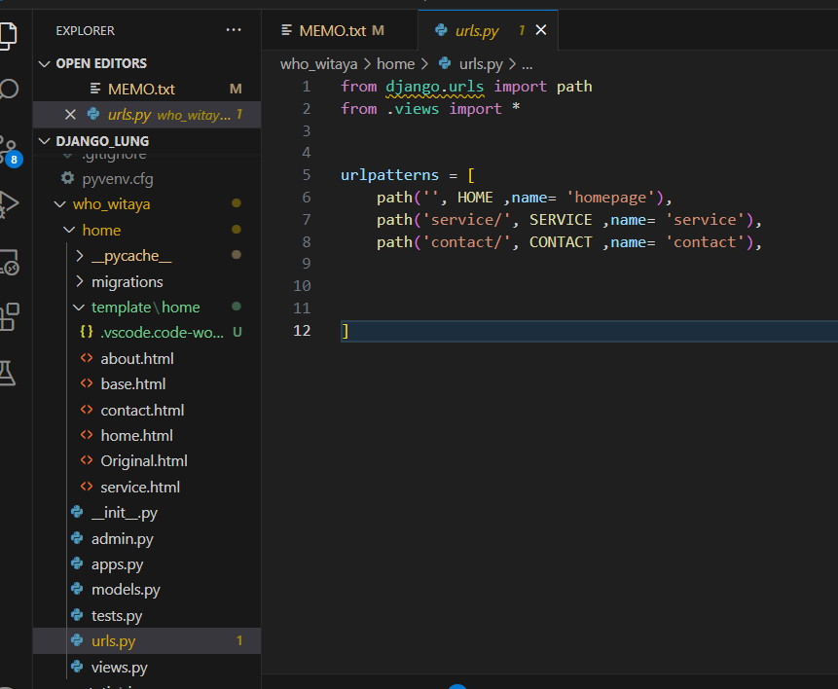
Template
Add block content and block list in base html
How to mange favicon
Link nav on base to other page with surname

Slide 18
<div class= "container">
<form method="POST">
{% csrf_token %}
<div class="form-group">
<label for="title">สอบถามหัวข้อ</label>
<input class="form-control" type="text" name="title" id="title">
</div>
<div class="form-group">
<label for="email">อีเมล์</label>
<input class="form-control" type="text" name="email" id="email">
</div>
<div class="form-group">
<label for="detail">รายละเอียด</label>
<textarea class="form-control" row="5" id="detail" name="detail"></textarea>
</div>
ิ <br>
<button type="submit" class="btn btn-primary">ส่งข้อความ</button>
</form>
</div>

Slide 19
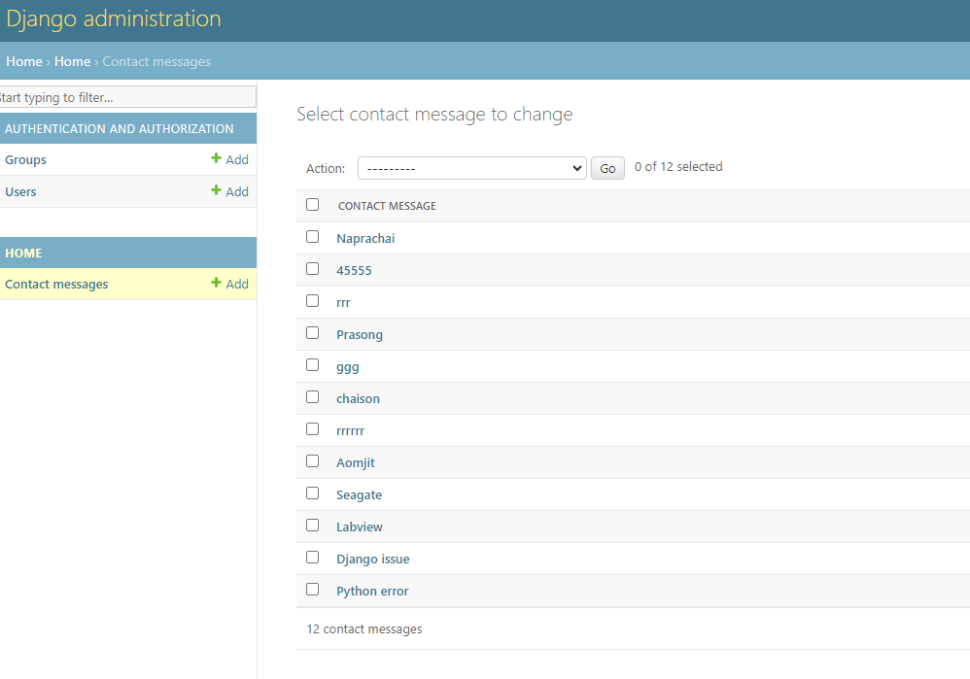
Form input
Div class container
Class form-group
Username (leave blank to use 'lenovo'): adminEmail address: witayachai@gmail.comPassword: 12345678
Admin
12345678

Slide 20
def CONTACT(request):
context = {}
if request.method =='POST' :
data = request.POST.copy()
title = data.get('title')
email = data.get('email')
detail = data.get('detail')
print(data,title,email)
if title =='' or email =='':
context['status'] = 'Witaya'
return render(request ,'home/contact.html',context) new =ContactMessage()
new.title = title
new.email = email
new.detail = detail
new.save()
context['status'] = 'success' return render(request ,'home/contact.html',context)

Slide 21
from django.db import models
# Create your models here.
class ContactMessage(models.Model):
title = models.CharField (max_length=100)
email = models.CharField (max_length=100)
detail = models.TextField (blank=True ,null=True)
def __str__(self):
return self.title

Slide 22
Form ต้องรับค่าจากลูกค้า ดังนั้น views ต้องมีคุณสมบัติในการรับค่าได้
Form ต้อง add CSRF

Slide 23
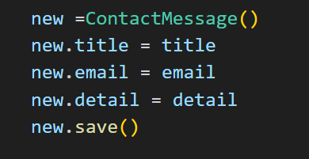
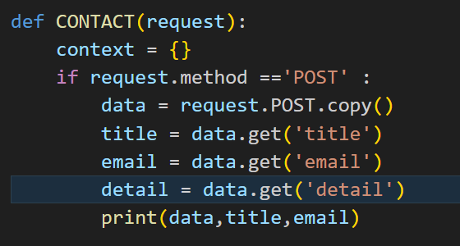
Save data to database
Save data from user
What is contact message

Slide 24
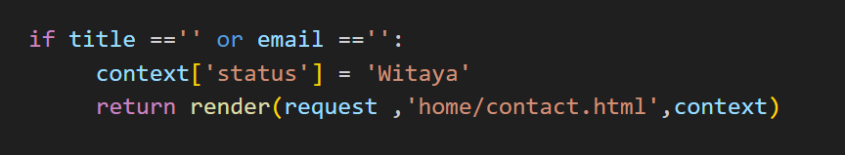
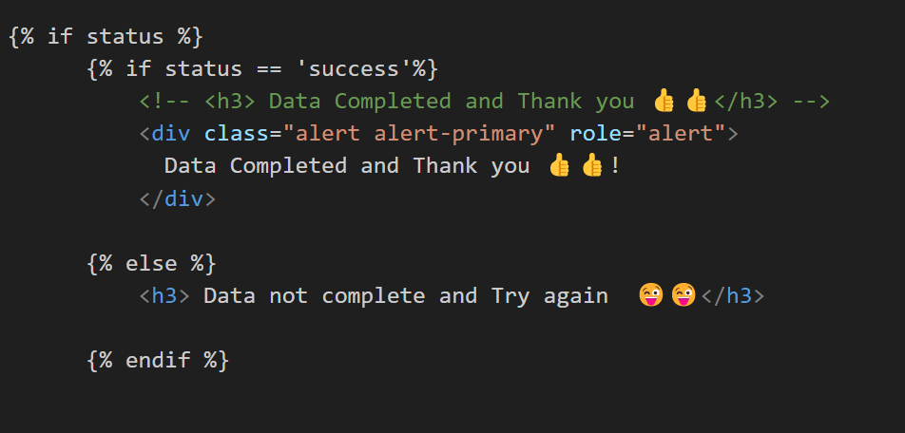
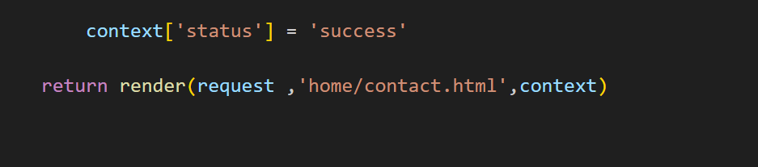
context = {}

Slide 26
{% block content %} | {% endblock content%}
{% block link %} | {% endblock link%}
{% block title %} | {% endblock title %}
Bootstrap form
<form method= “POST”>
< div class = “form-group”>
<input class="form-control> | ทำให้ form สวย
BS alert | Bootstrap BS alert
How to clear form after submit
What is CSRF

Slide 27
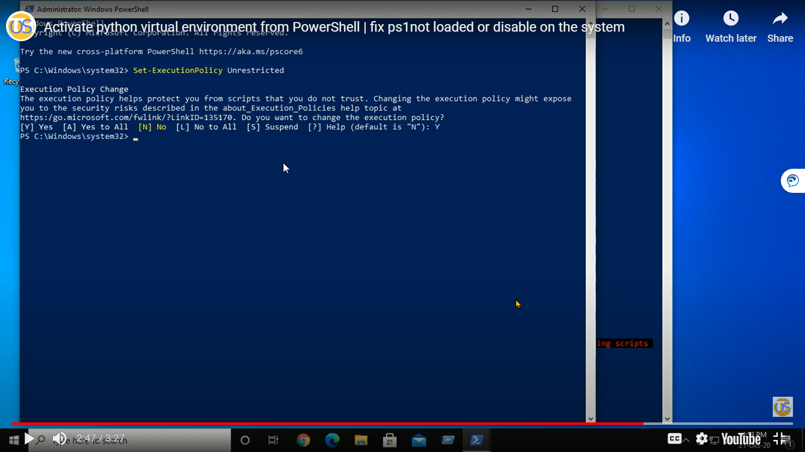
1.Open power shell and Run with admin
2.Set-ExecutionPolicy unrestricted ==> Y

